Slide 1

Introduction to Workshop
11-Mar-2025
Karthiganesh Durai
Founder & CEO, KwantumG Research Labs Pvt Ltd, Bengaluru
Co-Founder, Quantum Computing India, Bengaluru
Professor of Practice, NMIT, Bengaluru
TJohn, Bengaluru
DevOps Workshop
1/1, 11-Mar-2025

Slide 2
Without DevOps
How it Worked
Operations teams handled infrastructure, server maintenance, and security separately.
Used monolithic architectures (large, single-codebase applications).
Scaling was difficult, requiring manual setup of new servers.
Challenges
Slow Infrastructure Provisioning: Setting up new servers took weeks or months.
Environment Mismatches: "It works on my machine" issues due to different dev/prod environments.
High Downtime Risk: No automated monitoring or rollback mechanisms.

Slide 3
With DevOps
Pre-DevOps Challenge | DevOps Solution
Slow software releases | Continuous Integration & Continuous Deployment (CI/CD)
Siloed Dev & Ops teams | Collaboration & shared responsibilities
Manual deployments | Automated deployment pipelines
Infrastructure bottlenecks | Infrastructure as Code (IaC)
Security issues | Shift-left security (DevSecOps)
Frequent failures in production | Continuous monitoring & feedback loops

Slide 4
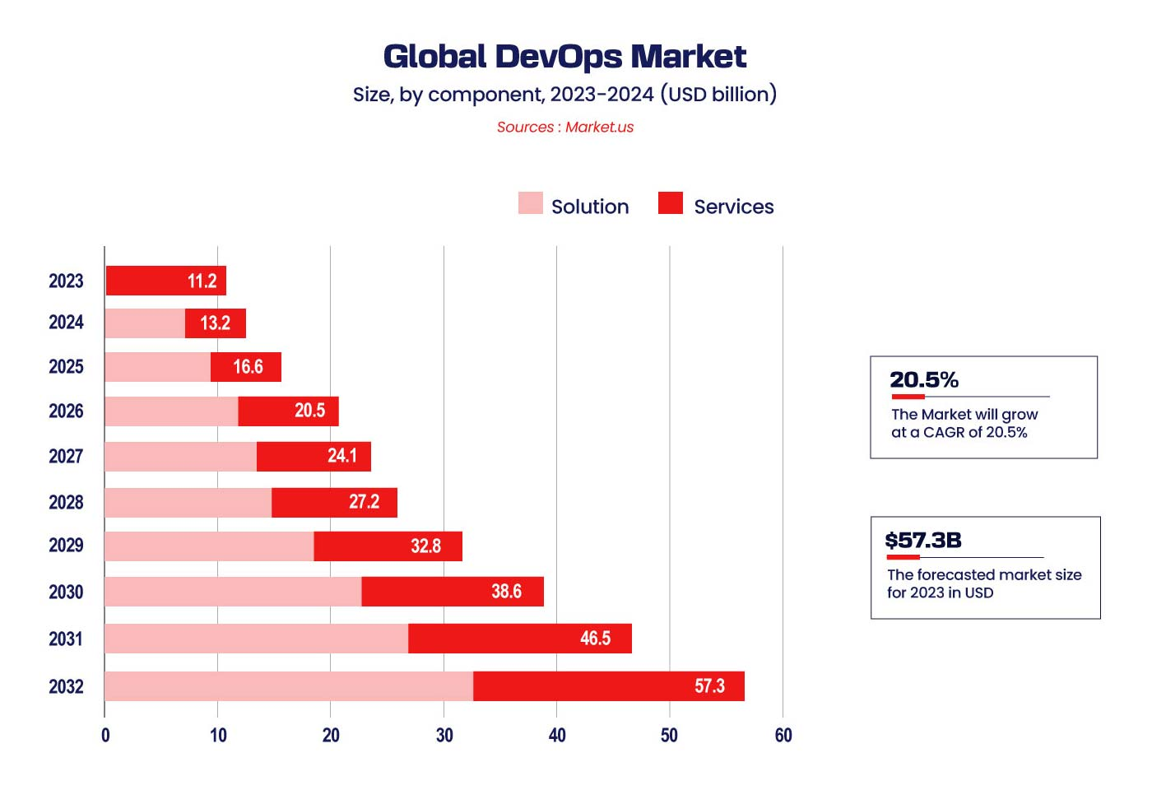
Demand for DevOps
https://enhops.com/blog/2024-devops-trends-a-glimpse-into-the-future-of-agile-operations

Slide 5
Demand for DevOps
Job Roles | Skills Required | CTC/Year
Project Engineer | Agile, cloud, HTML, testing, etc | 4.1L
System Engineer | Linux, automation tools, VMware, etc | 4.3L
Senior Engineer | Python, Linux, Automation, Agile, etc | 6.5L
DevOps Engineer | DevOps, Linux, Kubernetes, Automation, etc | 7L
Release Engineer | Release management, configuration management, Linux, etc | 7L
Lead Engineer | Python, Agile, automation tools, Linux, etc | 10.3L
Software Development Engineer | Agile, Linux, Programming, Data Structures, etc | 10.4
https://www.edureka.co/blog/devops-engineer-salary/

